Slide 1
Logistic Regression

Slide 2
Today . . .
  Generalized linear models
  Binary logistic regression

Slide 3
The general linear model (ordinary least squares, OLS) that underlies common analyses such as multiple regression assumes continuous and normally distributed outcomes.
Some common outcomes do not fit those assumptions:
  Binary outcomes (e.g., alive vs. dead, pregnant or not pregnant, etc.)
  Multinomial outcomes (e.g., single, married, divorced; rating scale data)
  Counts (e.g., number of arguments; number of serious life events).

Slide 4
Why not just use OLS?
  In some cases OLS might produce a reasonable approximation, but it might not be the best approximation available.
  In some cases, OLS will produce absurd results. Using a binary outcome in a multiple regression can produce predicted values that exceed the bounds of 0 and 1.
  In some cases it makes no sense (a multiple categorical variable with no order to the categories).

Slide 5
Sometimes a non-normal variable (e.g., counts) can be transformed to be approximately normal and then OLS can be used.
But the outcome then is in an unfamiliar metric.
An alternative—generalized linear models—assumes a different (non-normal) distribution for the outcome and then attempts to model that directly.

Slide 6
Generalized linear models have three basic features:
  Random component—the response variable—that has a known (or strongly expected) underlying distribution.
  A systematic component that reflects the predictor or explanatory variables for the response.
  A link function that transforms the expected value for the response to a linear relation with the predictors. The link function connects the random and systematic components.

Slide 7
The simplest generalized linear model addresses the simplest kind of outcome—a binary variable.
  The problem with using a simple OLS regression is that the outcome is bounded by 0 and 1. It makes no sense to speak of values beyond those limits, but values beyond those limits might be predicted.
  When the limits are respected, the predictors will be nonlinearly related to the outcome.
  It would be better if the outcome were unbounded and the model a linear one.

Slide 8
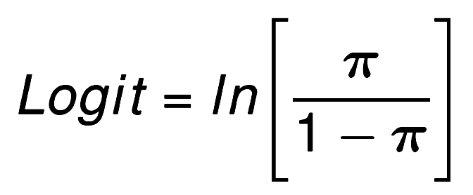
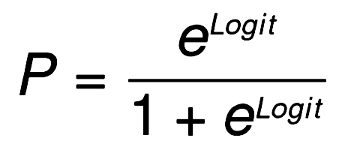
A single trial binary outcome has a Bernoulli distribution with parameter, π, equal to the probability of the outcome Y=1 occurring.
The bounded probability can be transformed to an unbounded value using the logit link function:
A linear model for the logit can be related back to the original probability metric through the inverse of the link function.
Notes:
A special case of the binomial.

Slide 9
Logistic regression builds a linear model for logits. This links the linear model to the probability (π) metric via the link function, so interpretation is relatively easy. It has some distinct advantages over other approaches (e.g., discriminant analysis):
  Continuous and categorical predictors can be used
  Interactions can be included
  Nonlinearity (some forms) can be tested
  It generalizes well to more than two categorical outcomes.

Slide 10
Logistic regression shares many of the same limitations with OLS regression:
  Multicollinearity can limit interpretation
  A linear model is assumed, with provision for certain kinds of nonlinearity
  Outliers can distort the analysis

Slide 11
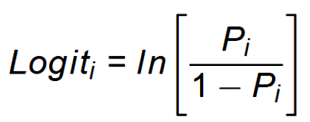
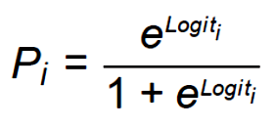
In logistic regression, the predictors are linearly related to the logit—the natural log of the odds:
These range from -∞ (P = 0) to ∞ (P = 1).
For ease of interpretation, the logits can be transformed back to probabilities:
The link function provides a way of moving between the response variable that is analyzed and the response variable that might be most easily interpreted.

Slide 12
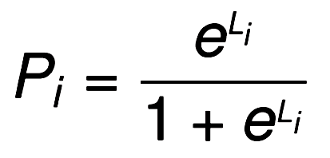
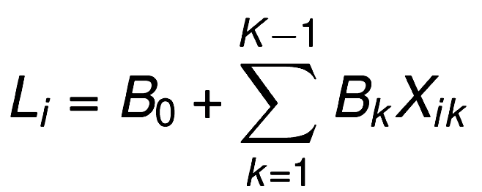
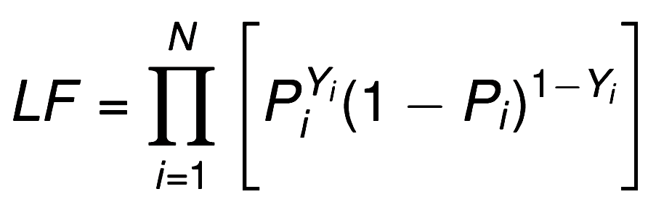
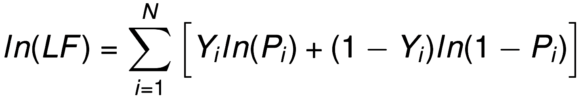
In logistic regression . . .
Probability that event occurs for Person i
Linear combination of predictors that estimates the log of the odds.
The likelihood function, or joint probability of the sample data given L. When this is maximized, the “best” linear combination of X has been found (the Bs are optimal).
Mathematically easier to use the log of the likelihood function.
Y_{i} = 1 or 0.

Slide 13
Hypothetical data (N = 500) relating job search outcome (no job, job) to aggregate GRE score, number of publications, sex of applicant (men =1, women = 2) and years to finish degree.
Products of these predictors can be formed to test interactions and powers can be used to test polynomial nonlinearity.

Slide 14
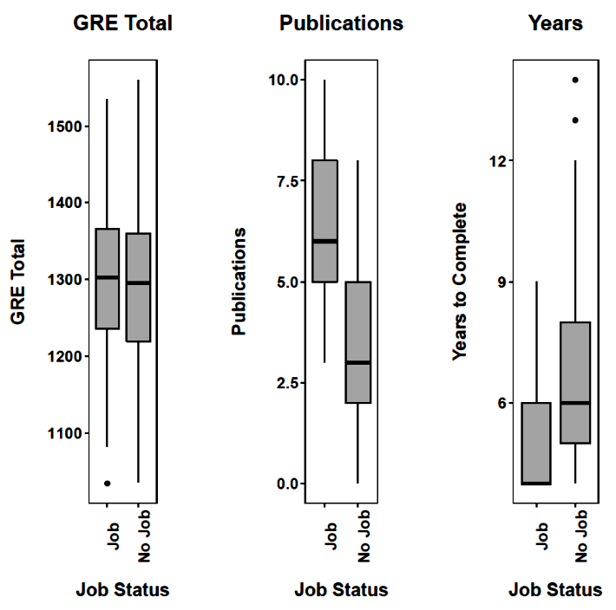
Job status is significantly related to number of publications and years to finish the degree.

Slide 15
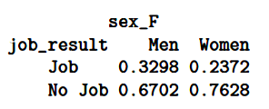
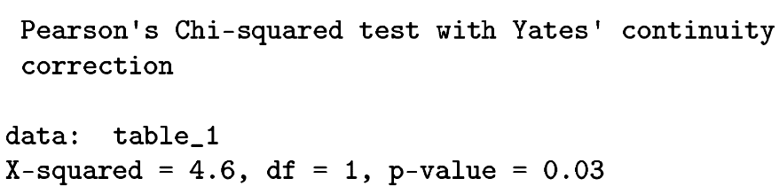
Women were less likely to get jobs than men.

Slide 16
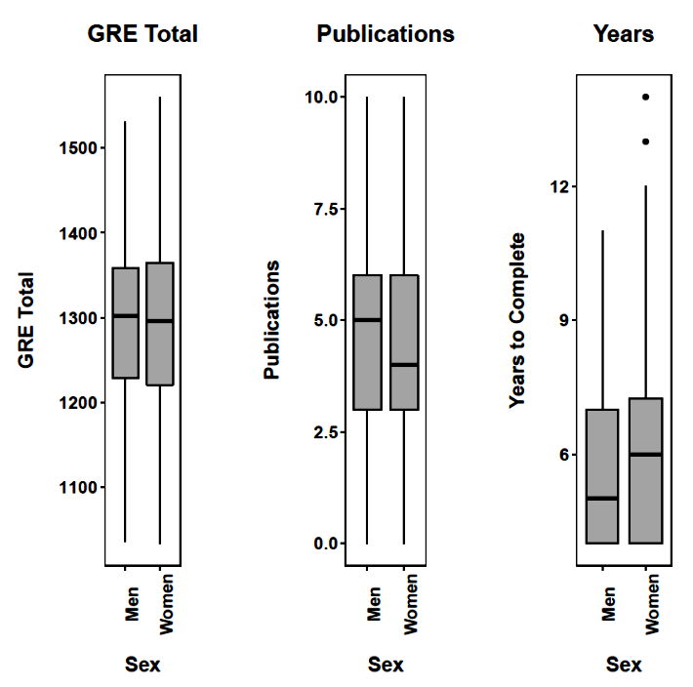
Men and women differed significantly in the number of years to complete the degree.

Slide 17
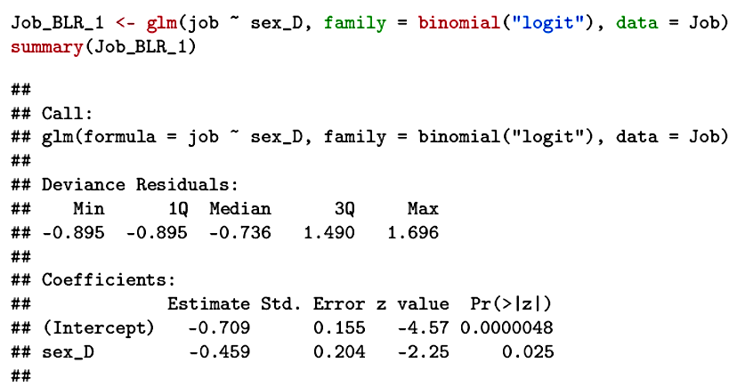
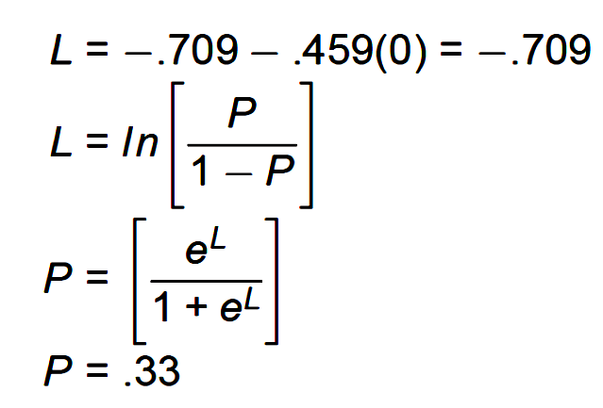
The regression equation is interpreted in much the same manner as in standard multiple regression except that the predicted score is the logit—the natural log of the odds:
There is a significant sex difference in the log odds of getting a job.

Slide 18
For men:
Men have a probability of getting a job of .33

Slide 19
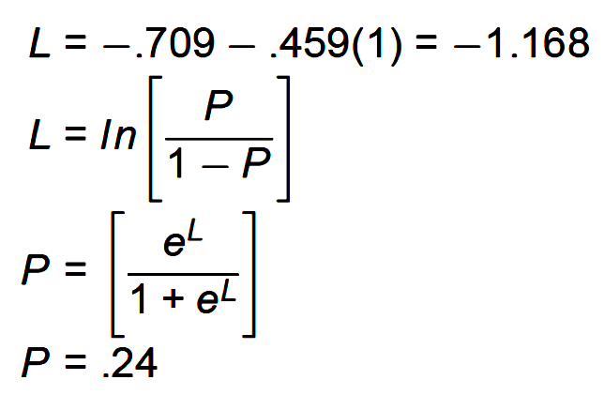
For women:
Women have a probability of getting a job of .24

Slide 20
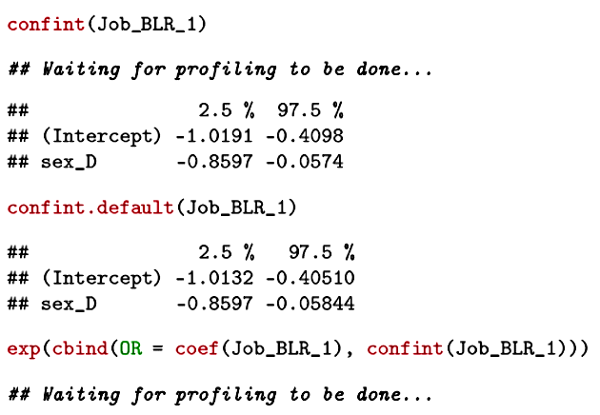

Confidence intervals can be placed around the coefficients (that predict logits) as well as the odds ratios (obtained by exponentiating the coefficients).

Slide 21
The odds of getting a job for men: .33/(1-.33) = .49
The odds of getting a job for women: .24/(1-.24) = .31
The odds ratio = .31/.49 = 0.63 = e^{B} = e^{-.459}
The odds of a woman getting a job are .63 times the odds of a man getting a job, not taking other predictors into account.

Slide 22
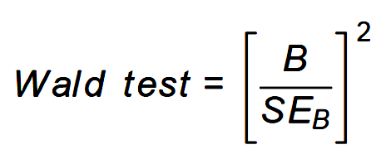
The Wald test is chi-square distributed. With 1 df, the square root of the Wald test can be interpreted as a Z test.

Slide 23
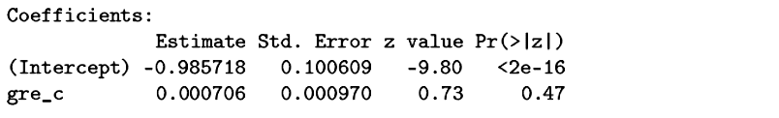
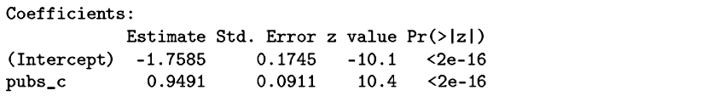
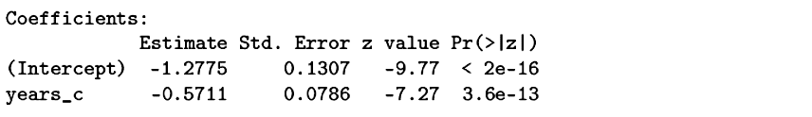

Slide 24
Publications are significantly related to the log odds of getting a job. Each additional publication increases the log of the odds by .949.
Each additional publication multiplies the odds of getting a job by 2.583.
The odds of getting a job change by 100(e^{B}-1)% with each additional publication. In this case, each publication increases the odds of getting a job by 158.3%.

Slide 25
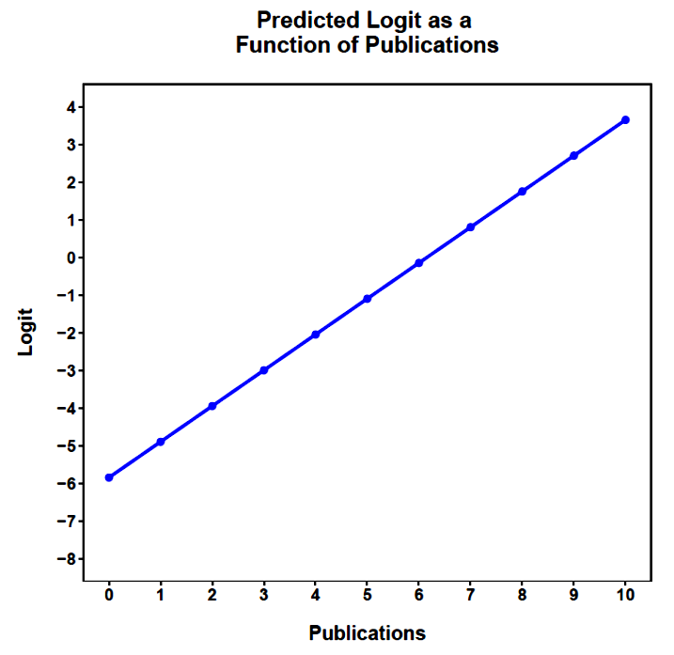
The regression equation can be used to predict the logit for different values of publications. This relationship must be linear.

Slide 26
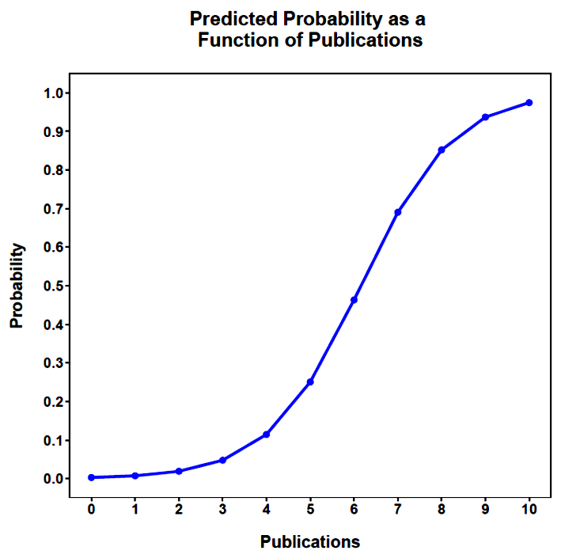
The logits can be converted to probabilities for easier interpretation.
The probability of getting a job is .5 when the logit is 0. Solving for publications produces 6.15.

Slide 27
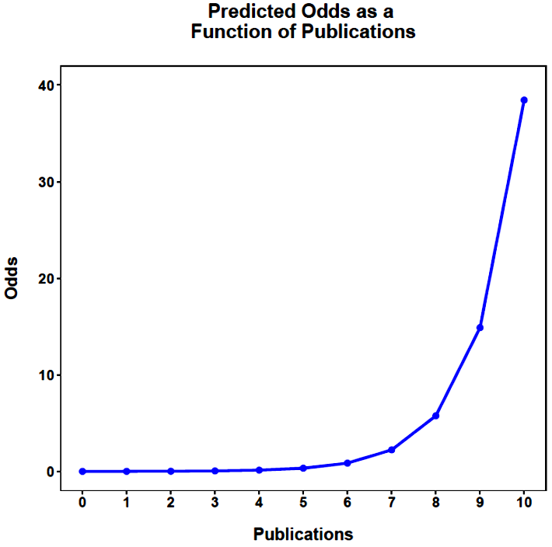
5.761-2.230
2.230
= 1.583 = e^{B} -1
5.76
2.230
= 2.583 = OR = (e^{B})
5.761
2.230

Slide 28
14.882-5.761
5.761
= 1.583
14.882
5.761
= 2.583
14.882
5.761

Slide 29
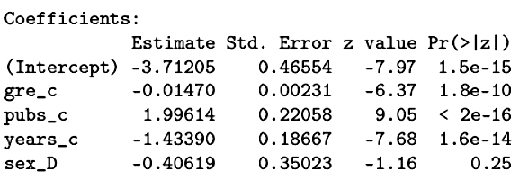
The best way to view the data is to enter all predictors simultaneously.
Now the relationships are partialled relationships, controlling for other predictors in the model.
Controlling for GRE, publications, and years to degree, there is no longer a sex difference in the odds of getting a job.

Slide 30
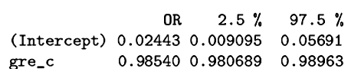
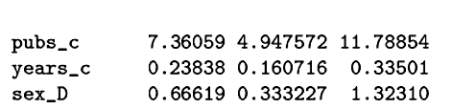
The interpretation of e^{B} is now with the qualification, “all else equal” or “holding other predictors constant.”
All else equal, each additional publication multiplies the odds of getting a job by 7.361.

Slide 31
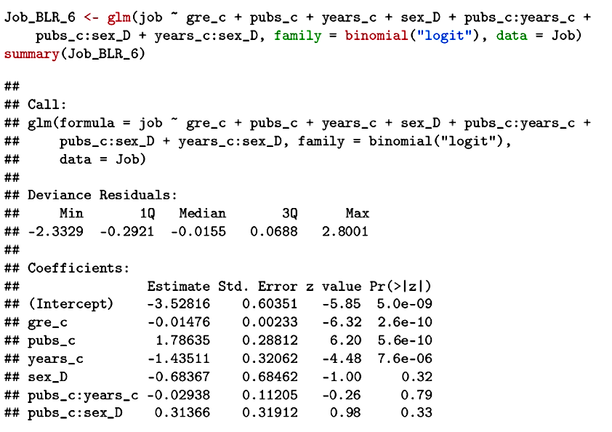
Interactions can be easily incorporated into the model.

Slide 32
Controlling other predictors at their means, the simple relation between publications and logits for men and women:
Men: L = -3.53 + 1.786(pubs_c)
Women: L = - 4.21 + 2.100(pubs_c)

Slide 33
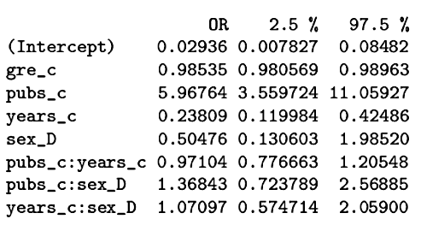
Each additional publication, multiplies the odds of getting a job by e^{B}, or 5.968 (e^{1.786}) for men and 8.166 (e^{2.100}) for women. The odds ratio is 8.166/5.968 = 1.368, the value of e^{B} for the interaction. Although not significant, this indicates that publications benefit women more than men.

Slide 34
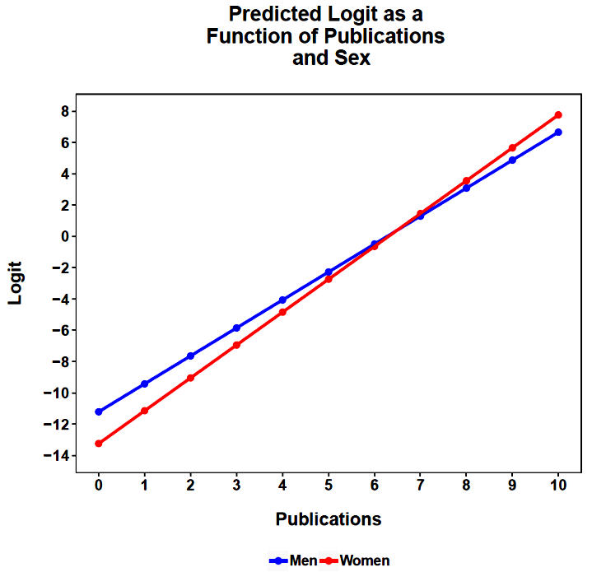
All else equal at the mean

Slide 35
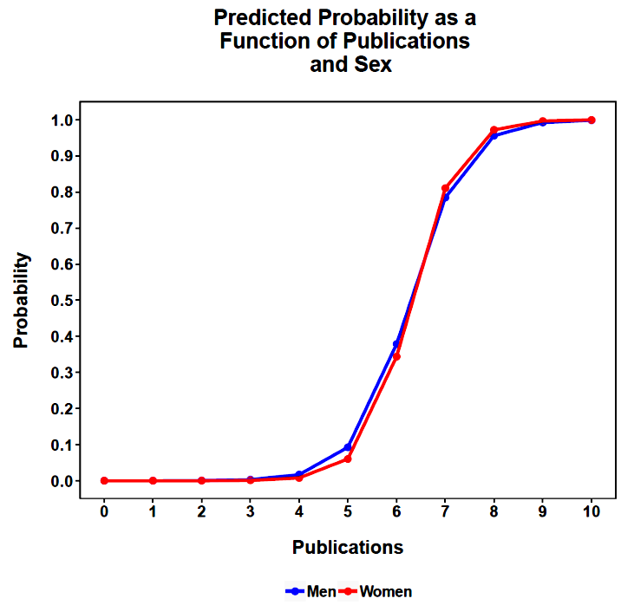
All else equal at the mean

Slide 36
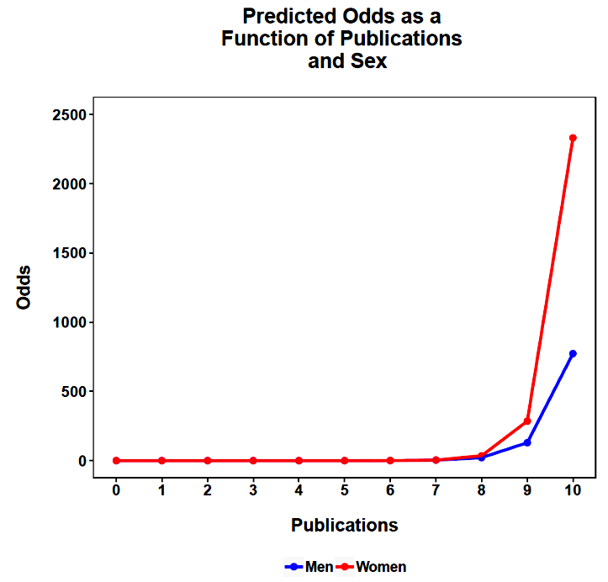
All else equal at the mean
Notes:
Note that this graph can be easily misinterpreted.
The odds ratio for the interaction is NOT the ratio of the odds for men versus women in the graph for any given value of publications.
Instead, it is the ratio of the odds ratio for men relative to the odds ratio for women.
The ratio of consecutive values in the graph, for men and women separately, gives the odds ratios for men and women respectively (higher odds relative to lower odds).

Slide 37
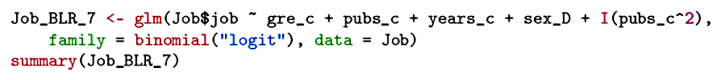
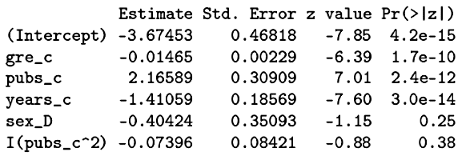
Nonlinearity can be incorporated into the model as well by adding powers of variables.

Slide 38
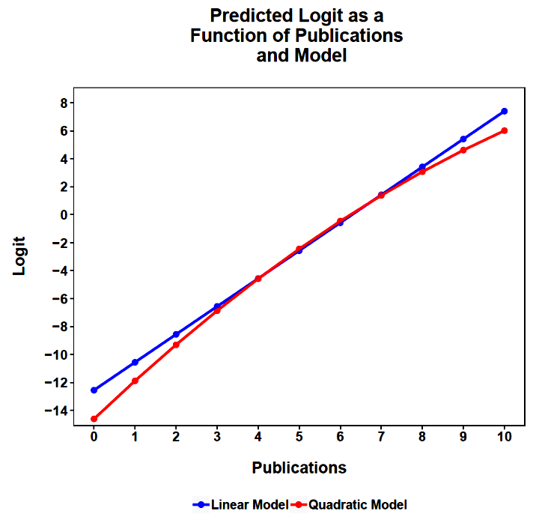
All else equal at the mean

Slide 39
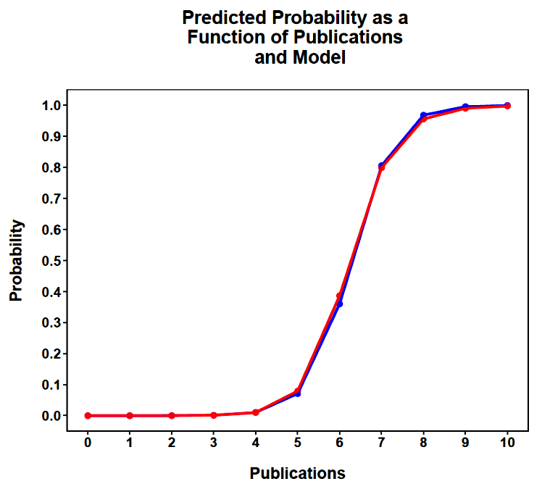
All else equal
at the mean

Slide 40
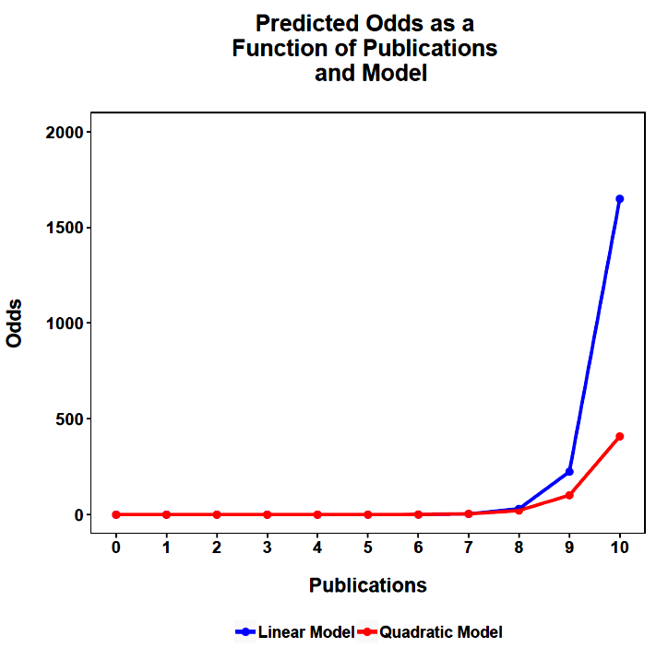
All else equal at the mean

Slide 41
Classification: For each case, the predicted logit can be transformed to a probability, which can then be used to classify participants into their expected job categories. These predicted classifications can be compared to the known job search outcome. The quality of these classifications can be assessed in the same way as was done with discriminant analysis (e.g., t, τ).
For these data, 88.8% of the cases are classified correctly, with τ = .72, and t(496) = 12.99, p < .001.

Slide 42
Next time . . .
  Model diagnostics
  Ordinal and multinomial outcomes

